Slide 1
Crowdfunding Your Invention
Mark Nowotarski (Patent Agent)
www.marketsandpatents.com
mark.nowotarski@gmail.com
203 975 7678

Slide 2
Crowdfunding
Make a prototype: Make a video: File a patent application.
Post on internet with pricing, funding goal, and funding deadline (e.g. 30 – 60 days).
Promote it: Promote it: Promote it!!!!!
Take committed orders guaranteed by credit card.
If you do meet your funding goal by funding deadline, everyone gets charged, you get $, you make and deliver the product.
If you don’t meet your funding goal, no one gets charged, you cry in your beer, and it’s back to the drawing board.

Slide 3
Example:

Slide 5
What Does it Take to be Successful?
Planning & Preparation – perhaps for a year
Prototype made
Production facilities lined up
Video – good but not too good
Business plan – break even, make money on licensing
Media coverage
Social Network – blogs/forums/moderators
Commercial – Gizmodo/Techcrunch /FastCompany/Huffpost /NYT
Wide range of award offerings ($1 to $1,000) with good rewards
Cool Factor – Inspiration Factor – Public Service Factor
Already be successful
If at first you don’t succeed, try try again.

Slide 6
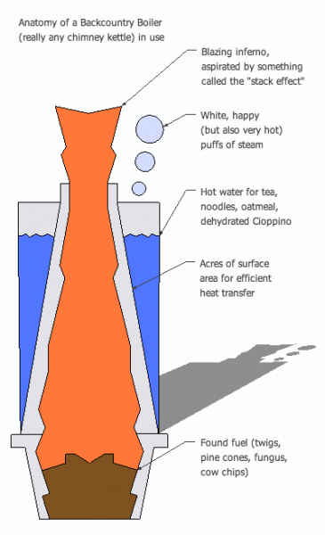
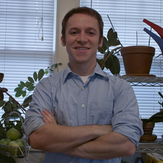
Backcountry Boiler:
Hot water from found fuel
Devin Montgomery
Pittsburgh PA
Recent graduate
563 Backers
$60,642 pledged of $20,000 goal

Slide 7
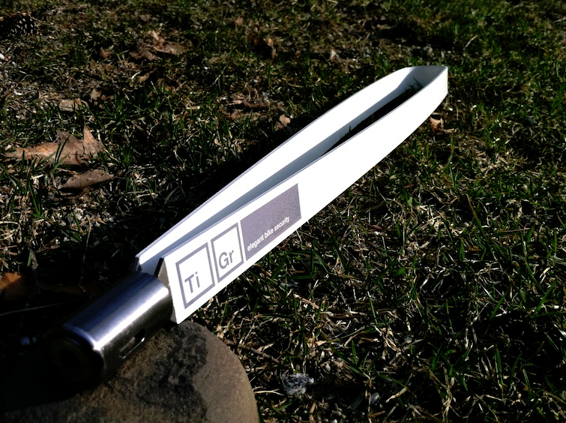
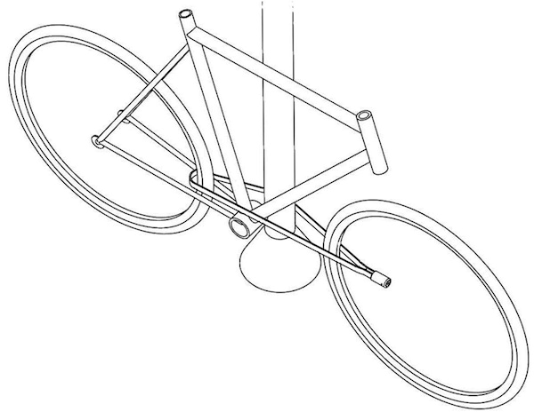
TiGr: Titanium Lock as Cool as your Bike
Bob and John Loughlin, Inventors, Engineers, Entrepreneurs, Lock Enthusiasts, Bike Riders, Father and Son
740 Backers
$108,065 pledged of $37,500 goal

Slide 8
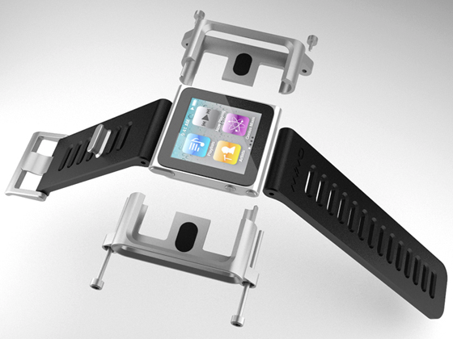
TikTok+LunaTik Multi-Touch Watch Kits
Scott Wilson is the founder of Chicago-based MINIMAL, a studio whose diverse work spans industries ranging from technology, interaction and consumer products to fashion, furniture and environments.
Original $50
13,512 Backers
$942,578 pledged of $15,000 goal
Licensed to Apple
Chinese knockoff $20

Slide 9
Bottom Line
Crowdfunding is an effective new way to raise money for initial product production.
Success depends upon good product design, meticulous planning, extensive promotion, and, as with many things in life, tireless persistence.

